Slide 2
The ACCEPT Project
Enabling machine translation for the emerging community content paradigm.
Allowing citizens across the EU better access to communities in both commercial and non-profit environments.
Duration: 2012 - 2014
Grant agreement : No. 288769

Slide 3
Consortium
(coordinator)

Slide 4
Trends and Challenges
Web 2.0 paradigms are democratizing content creation, stressing the value of communities.
Demand for translation of content is growing – machine translation (MT) is becoming much more pervasive.
But:
MT engines cannot produce acceptable results for community content due to the extreme variability within the content.
ACCEPT will address this issue by developing new technologies designed specifically to help MT work better in this environment.
ACCEPT’s mission is to help communities share information more effectively across the language barrier.

Slide 5
Research and Development
Main Avenues:
Development of new paradigms for “minimally intrusive” content pre-editing.
Development of strategies for content post-editing, leveraging the skills of monolingual domain experts volunteers.
Improvement of learning and development of feedback loops to improve Statistical Machine Translation (SMT) for community data.
Refinement of editing and translation strategies with text analytics and content classification.

Slide 6
1. Pre-editing
Development of user-friendly (minimally intrusive) strategies for pre-editing the content for statistical machine translation
The project identifies the most important types of corrections that need to be applied to the source content in order to attain a higher translation quality.
The project develops interfaces that help users to easily apply these corrections while they author their content.

Slide 7
2. Post-editing
Development of post-editing strategies
The project creates a user-friendly interface to support communities with post-editing their own content.
The lack of bilingual skilled experts for post-editing is a major bottleneck. The project will therefore develop monolingual post-editing strategies which do not require proficiency of the source language, thus enlarging the pool of (volunteer) skilled experts.

Slide 8
3. Improving SMT
Improvement of learning and development of feedback loops to improve Statistical Machine Translation (SMT) for community data.
Parallel data are sparse and heterogeneous in the user-generated content domain (UGC).
The project will develop innovative domain adaptation methods and will use linguistic information to cope with sparseness and heterogeneity.
It will take into account feedback from the post-editing process to automate corrections whenever possible.

Slide 9
4. Text Analytics
Apply automatic text analytics and content classification strategies to address the large variety in user-generated content
The project will develop automatic topic classification of user-generated content to enable domain-optimized, more reliable translation systems.
Noisy input data, such as forum posts with irrelevant chatter, will be filtered out to focus the improvement of translations on valuable data.
Topics, sentiment and other text features will used to ensure that the semantics is correctly conveyed in the translation. Post-editing will be focused on content that got lost during the translation.
The correlation between text features and the required post-editing effort will be examined.

Slide 10
Target Groups
The ACCEPT project will be addressing the challenge of removing the language barrier in two different scenarios:
content in a typical commercial product forum,
Symantec’s security-focussed Norton forum:
http://community.norton.com/norton/
content in the community of volunteer translators Traducteurs sans Frontières:
http://www.tsf-twb.org/
More generally, the project’s effects will be useful for all those who need information instantly and reliably translated into their own language, despite linguistic imperfections.

Slide 11
Project Overview
COMMUNITY DEVELOPMENT
PORTAL INTEGRATION
PRE-EDITING
SMT
POST-EDITING
TEXT ANALYTICS

Slide 12
Innovation
For the first time, pre-editing, MT and post-editing will be linked together not just in a process, or workflow, but by connecting the software components together and by developing new linguistic software components specifically optimized for community content translation.
COMMUNITY DEVELOPMENT
PORTAL INTEGRATION
PRE-EDITING
SMT
POST-EDITING
TEXT ANALYTICS

Slide 13
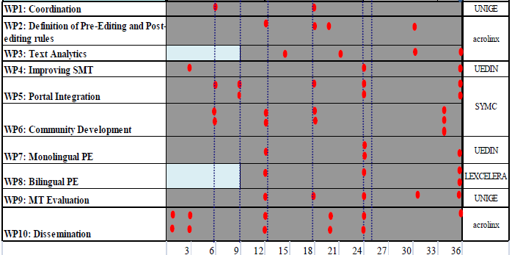
Work Packages
Work packages and deliverables

Slide 14
Impact
The technology developed throughout the ACCEPT project will contribute to the take-up of MT in the burgeoning area of user generated content.
ACCEPT will allow citizens across the EU better access to communities in both commercial and non-profit environments.
ACCEPT will make companies in Europe better able to engage with their customers across the language barrier, making them more competitive and allowing them to expand more quickly across Europe.
ACCEPT’s scientific and technical innovation will help drive take-up of MT in this new Web 2.0 paradigm.
The social impact is highlighted in the participation of Traducteurs sans Frontières, whose focus is helping European NGOs provide better services in multilingual theatres of operations.

Slide 15
Progress and Results

Slide 16
Schedule
3
6
9
12
15
18
21
24
27
30
33
36

Slide 17
Results
User interfaces for pre-editing, post-editing, evaluations developed (ACCEPT portal)
Set of pre-editing rules developed
Pre-editing functionality deployed in the Norton Community Forum
Scientific papers published; Special Interest Group established with representatives from industry and NGOs
Working with the TWB community; first evaluations with post-editing carried out
Baseline SMT engines generated

Slide 18
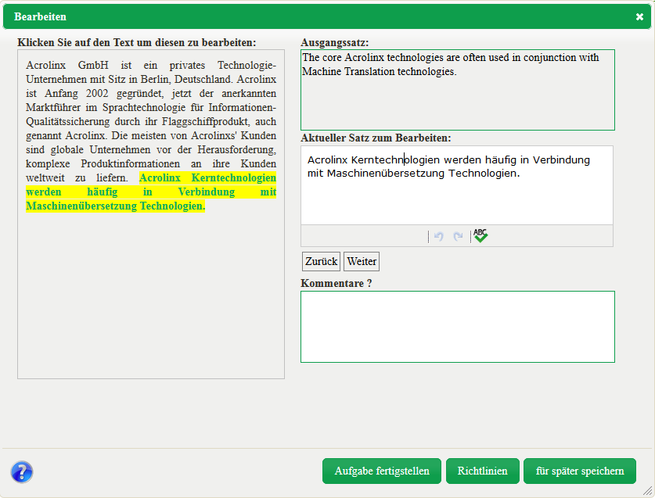
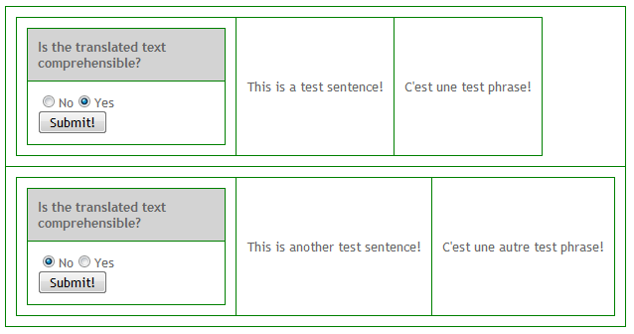
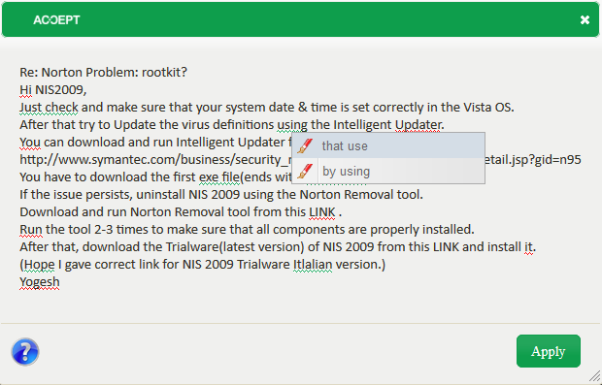
ACCEPT Portal
Demonstration of pre-editing, post-editing, and evaluation interfaces

Slide 19
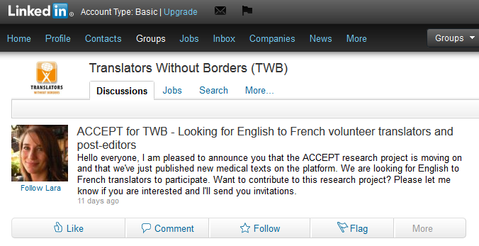
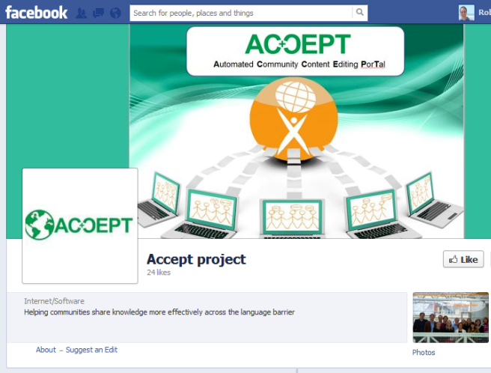
Integration in Communities
Pre-editing functionality in Norton Community Forum
Communication with Translators Without Borders community

Slide 20
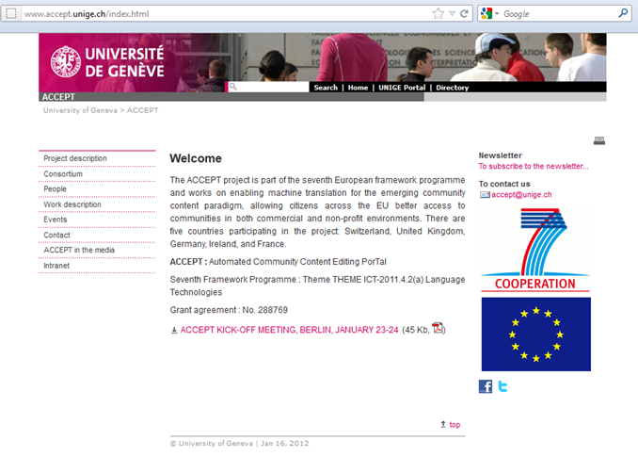
More Information
www.accept-project.eu

Slide 21
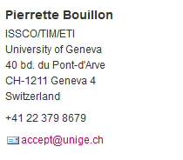
Contact

