Slide 1
Evaluating Community Post-Editing - Bridging the Gap between Translation Studies and Social Informatics
Grant agreement: 288769
Linda Mitchell
PhD student - Dublin City University

Slide 2
Outline
Research Topic
Social Informatics
The Norton Community
Recruitment
Overview: Evaluation Methods
Developing the Evaluation Widget

Slide 3
Research Topic
Post-editing of user-generated machine translated content by volunteer community members of the Norton support forum
Norton Forum: online platform to exchange knowledge on Norton products
User-generated: The content are questions and answers written by community members
Machine translated: translated from English into German using an SMT system
Post-editing: Correction of machine translated content
Volunteers: users of the Norton forums (not translators)

Slide 4
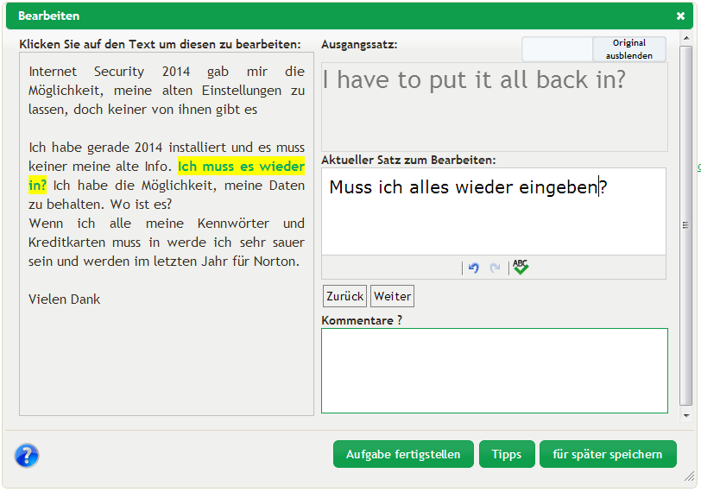
Research Topic
Notes:
18 post-editors (en-de), post-editing 160 segments

Slide 5
Main research question
What kind of output do volunteer community post-editors produce?
Translation Studies: quantitative methods
Categorise errors, rank post-editing solutions etc.
Post-editing quality:
“a good post-editor would meet the requirements of the specific PE tasks at hand, making changes and corrections only according to the guidelines provided, and delivering a final text with the required level of quality in the time-frame specified” (de Almeida 2013)
→ Requirements and level of quality depend on environment

Slide 6
The need for Social Informatics
Post-editing environment is an existing online community
…Body of research that examines the social aspects of computerisation
Design and configuration of information systems that work well for people and help support their work (Kling 2000)
Community needs to be studied to perform:
Recruitment and support of participants
Design of Evaluation Widget and tasks
Qualitative Methods (observation, questionnaires, communication)

Slide 7
Online Community – Analysis I
They will be communities not of common location, but of common interest (Rheingold 2000: 9)
The Norton community:
Main interest: receiving help and solving problems related to Norton products
Secondary interest: exchanging ideas about (new) Norton products, how to improve Norton products
Tertiary interest: forming bonds with other community members
Community PE <> Crowd PE

Slide 8
Online Community – Analysis II
Self-sustained:
Questions and answers are supplied by the community
Self-governed:
Moderators and administrators monitor
Community reports/takes care of misconduct itself
Creation
Growth
Maturity
Inception
Online Communities
Life-Cycle
(Iriberri & Leroy 2009)
Death

Slide 9
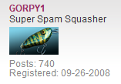
Online Community – Analysis III
Lurker
Once-off user
Regular user
Guru

Slide 10
Recruitment
User Study 1: (Mitchell, Roturier and O’Brien 2013)
No natural interest for MT or PE
Low cooperativeness from super users
User Study 2:
Public posts are seen but do not stir interest
Personalised messages!
Positive turnout:
91 invitations → 18 participants (20%)

Slide 11
My Evaluation Methods
Linguistic Evaluation
Error categorisation based on de Almeida 2013
Professional Evaluation
Domain experts
Advanced language skills/ trained linguists
Fluency and fidelity (LDC 2005)
Community Evaluation
Fluency
Quantitative
methods (Translation Studies)
Facilitated by qualitative methods (Social Informatics)

Slide 12
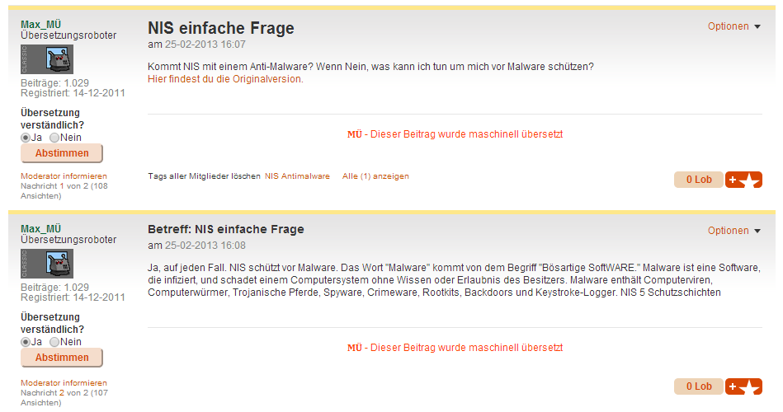
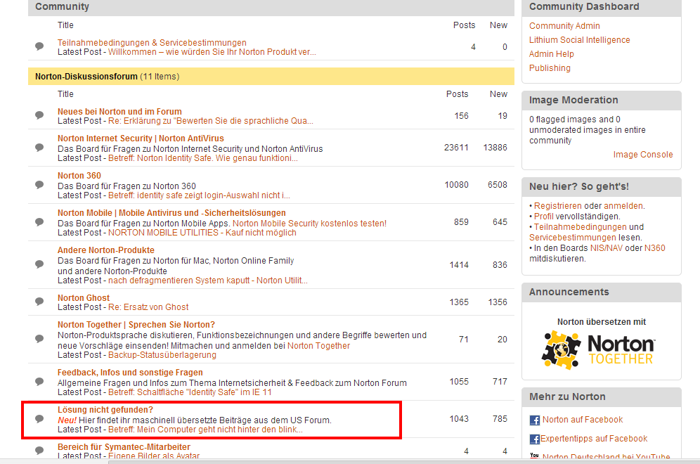
Developing Evaluation Widget
(Mitchell and Roturier 2012)

Slide 13
Developing Evaluation Widget – Learning Points
Simple Design
Visibility
Simple Task
Provide Support/ Explanation
(Fun / Rewarding Task)

Slide 14
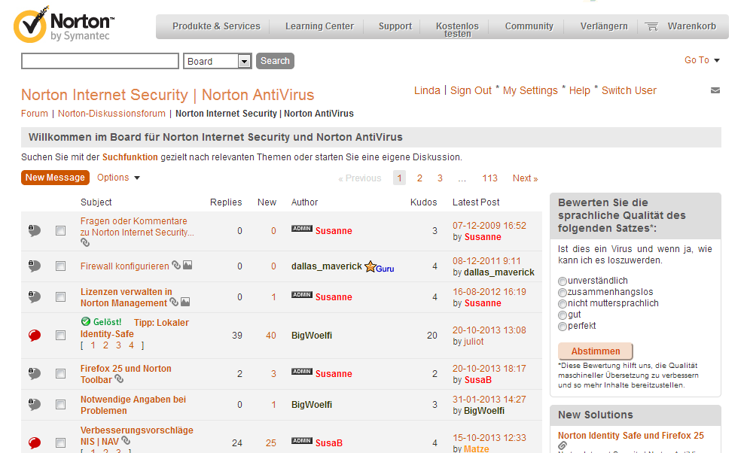
Implementation
Notes:
- 1470 ratings in four weeks
From 4 ratings a week to 368 ratings a week

Slide 15
Grant agreement: 288769
Linda Mitchell
linda.mitchell7@mail.dcu.ie

Slide 16
References
De Almeida, G. 2013. Translating the post-editor: an investigation of post-editing changes and correlations with professional experience across two Romance languages. PhD dissertation. Dublin City University.
Iriberri, A. and Leroy, G. 2009. A life-cycle perspective on online community success. ACM Computing Surveys, 41(2): 1-29.
Kling, R. 2000. Learning About Information Technologies and Social Change: The Contribution of Social Informatics. The Information Society, 16: 217-232.
Linguistic Data Consortium. 2005 Linguistic data annotation specification: assessment of fluency and adequacy in translations Revision 1.5, http://projects.ldc.upenn.edu/TIDES.Translation/TransAssess04.pdf
Mitchell, L and Roturier, J. 2012. Evaluation of Machine-Translated User Generated Content: A pilot study based on User Ratings. Proceedings of the 16th Annual Meeting of the European Association for Machine Translation, 61-64.
Mitchell, L. Roturier, J. and O’Brien, S. 2013. Community-based post-editing of machine-translated content: monolingual vs. bilingual. Proceedings of MT Summit XIV Workshop on Post-editing Technology and Practice.
Rheingold, H. 2000. The Virtual Community: Homesteading on the Electronic Frontier. Cambridge: MIT Press.

